Slide 1

Autonomous Vehicle Planning & Control
Using Reinforcement Learning with MetaDrive
Team Members: Kaivalya Jadhav and Paul Pekala
Apri 04 2026

Slide 2
Project Overview
• MetaDrive simulator for autonomous driving research
• Soft Actor-Critic (SAC) reinforcement learning algorithm
• Train models with Multi-modal sensor observation:
LiDAR Sparce
LiDAR Dense
BEV
RGB Camera
• Training on 800 unique maps, evaluation on 200 held-out maps
• Total seed range: 0-799 (training), 800-999 (evaluation)
• Target: 1 million timesteps per modality

Slide 3
Project Progress
Model trained -
  Sparse LiDAR
    Observation - 80 laser beams, 50m range
    Policy Used - MlpPolicy
  Dense LiDAR (240 beams, 100m) - MlpPolicy
    Observation - 240 laser beams, 100m range
    Policy Used - MlpPolicy
Both models trained to 1M timesteps
Trained on 800 unique maps, evaluation on 200 held-out maps

Slide 4
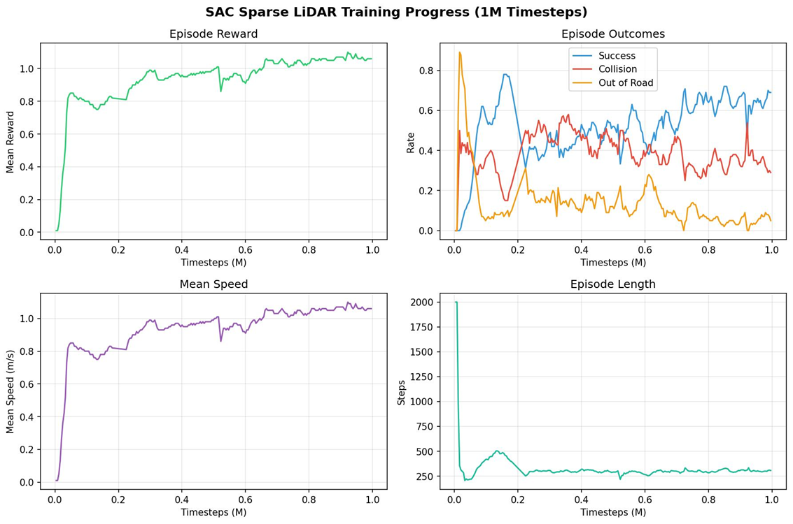
Sparse LiDAR Training Progress

Slide 5
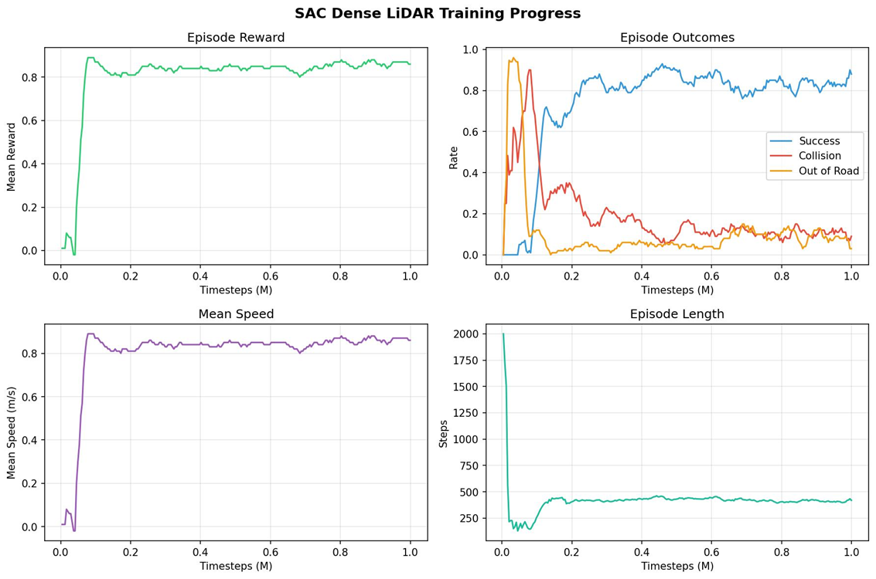
Dense LiDAR Training Progress

Slide 6
Next Steps
Next step is to train two more models -
  Bird's Eye View -
    Top-down semantic segmentation
    128x128 image observation
    Policy Used - CnnPolicy (convolutional neural network)
  RGB Camera -
    128x128 image observation
    Policy Used - CnnPolicy (convolutional neural network)
Expected challenges:
  Higher dimensional input (3 channels vs LiDAR)
  May require more training timesteps
Potential advantages:
  Richer visual information
  More realistic sensor setup

Slide 7
Autonomous Vehicle Planning and Control - Kaivalya Jadhav and Paul Pekala
Project Overview
Training Progress
Next Steps
MetaDrive simulator for autonomous driving research
Soft Actor-Critic (SAC) reinforcement learning algorithm
Multi-modal sensor observations:
  LiDAR Sparse
  LiDAR Dense
  BEV (Bird's Eye View)
  RGB Camera
Training on 800 unique maps, evaluation on 200 held-out maps
Seed range: 0–799 (train), 800–999 (eval)
Target: 1 million timesteps per modality
Models trained:
  Sparse LiDAR
    Observation – 80 laser beams, 50m range
    Policy Used – MlpPolicy
  Dense LiDAR
    Observation – 240 laser beams, 100m range
    Policy Used – MlpPolicy
Both models trained to 1M timesteps ✓
Trained on 800 unique maps, evaluation on 200 held-out maps
Next step: train two more models
  Bird's Eye View (BEV)
    Top-down semantic segmentation
    128×128 image observation
    Policy Used – CnnPolicy
  RGB Camera
    128×128 image observation
    Policy Used – CnnPolicy
Expected challenges:
  Higher dimensional input (3 channels vs LiDAR)
  May require more training timesteps
Potential advantages:
  Richer visual information
  More realistic sensor setup

